Slide 1
Income Inequality

Slide 2
Seven Unitarian Principles
Inherent worth and dignity of every person
Justice, equity and compassion
Democratic process in society at large

Slide 3
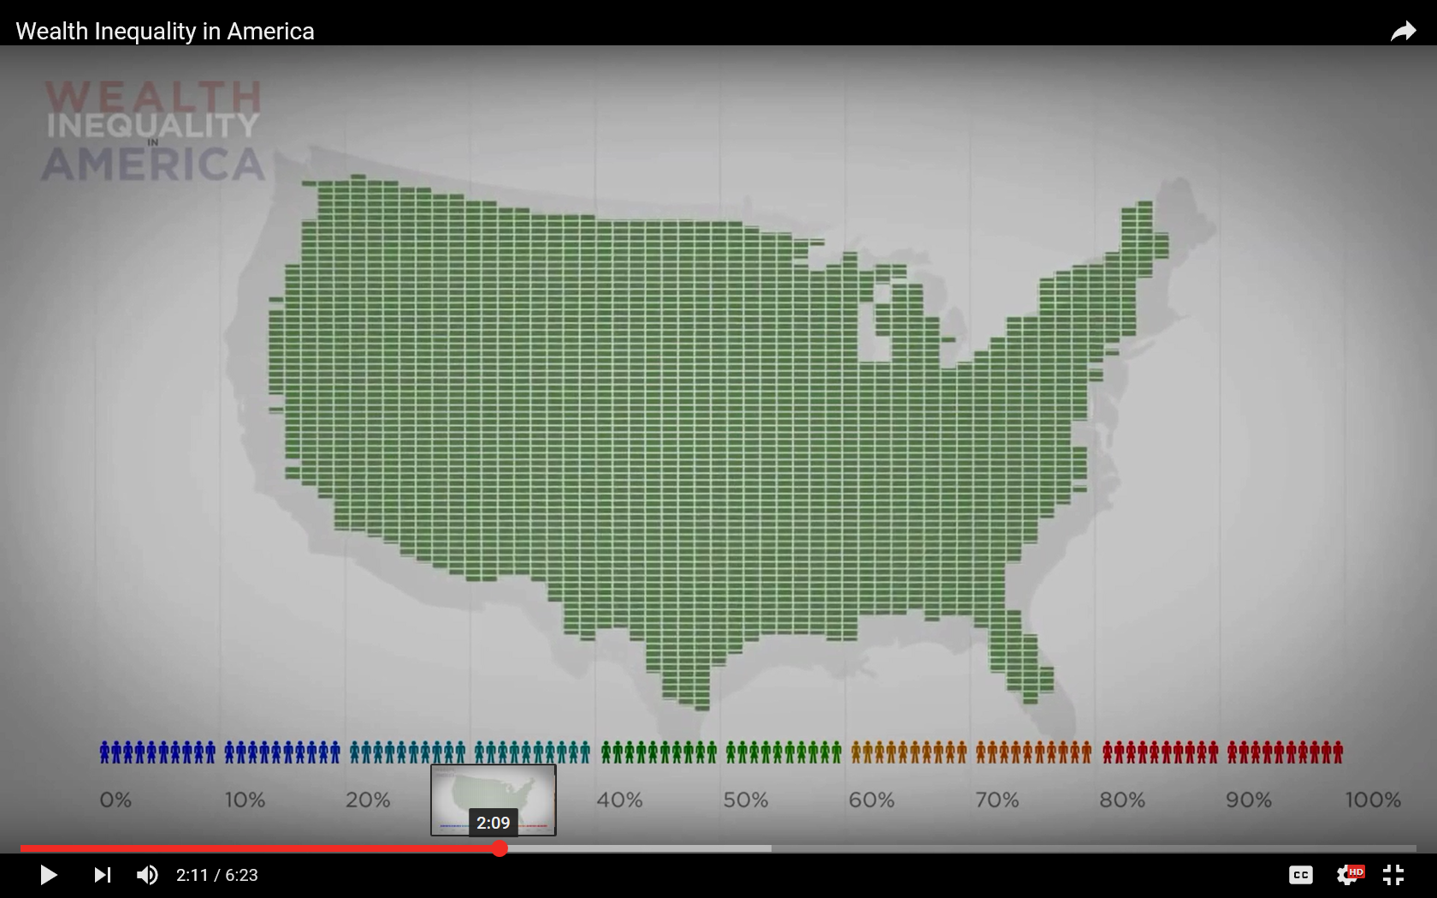
How Is Wealth Distributed?

Slide 4
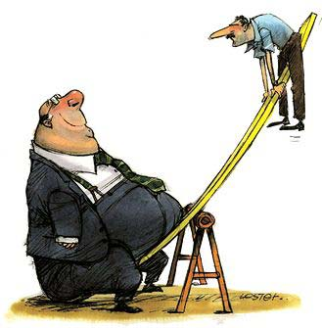
Living in a Mythical Country
Not This

Slide 5
Top 10 % Income Share 1917-2008

Slide 6
Myth: How Wealth is Distributed
Video

Slide 7
Myth: How Wealth is Distributed
What Americans Want it to Be

Slide 8
Myth: How Wealth is Distributed
What the Distribution Actually Is

Slide 9
Myth: US is pretty equal
Notes:
In OECD countries today, the average income of the richest 10% of the population is about
nine times that of the poorest 10% – a ratio of 9 to 1. However, the ratio varies widely from one
country to another. It is much lower than the OECD average in the Nordic and many
continental European countries, but reaches 10 to 1 in Italy, Japan, Korea, and the United
Kingdom; around 14 to 1 in Israel, Turkey, and the United States; and 27 to 1 in Mexico and
Chile.

Slide 10
How About Economic Mobility?
Through much of the nation’s history, absolute mobility was high. But for those born after 1970… absolute mobility has declined.
(Brookings, Economic Mobility in America, 2008)

Slide 11
What’s “Good” About Inequality?
“It motivates people”
“Different economic outcomes are ‘natural’”
“‘Fixing’ it is socialism, a cure worse than the disease”

Slide 12
What’s Bad About Inequality?
Morally repugnant
Dangerous to democracy
Hurt the poor and middle class
Tear apart our social fabric

Slide 13
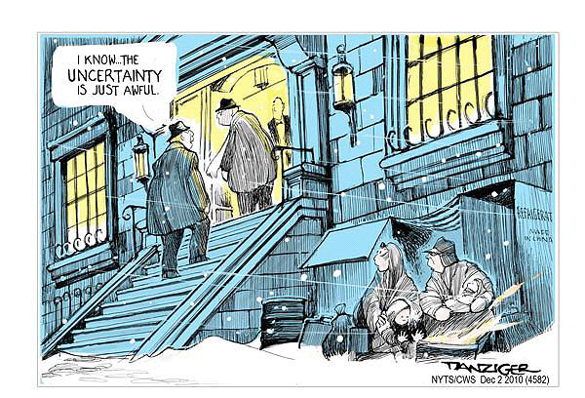
Morally repugnant

Slide 14
Tearing Apart Our Social Fabric
A cultural chasm has developed between the traditional middle class and the top 30 percent…
Atlantic, Can the Middle Class Be Saved, Don Peck Sept. 2011
Notes:
The family lives of today’s moderately educated Americans, which in the 1970s closely resembled those of college graduates, now increasingly resemble those of high-school dropouts, too often burdened by financial stress, partner conflict, single parenting, and troubled children.

Slide 15
Undermines Citizenship
“The U.S.-based CEO of one of the world’s largest hedge funds told me that the hollowing-out of the American middle class didn’t really matter.”
Atlantic, “The Rise of the New Global Elite”
Notes:
“…if the transformation of the world economy lifts four people in China and India out of poverty and into the middle class, and meanwhile means one American drops out of the middle class, that’s not such a bad trade”.

Slide 16
The Rich are SO Rich!
299
243
126
24
Notes:
In Germany excessive executive compensation is mitigated by such institutional features as the two‐tier company
board with strong labor representation, “legal co‐determination rights,” and a high tax
rate on capital gains from stock options” (Ponssard, 2001).

Slide 17
It Corrupts Our Politics
Money for House and Senate Campaigns
1974 $77 million
1982 $343 million
2010 $1.8 billion
2012 3-5 x more!

Slide 18
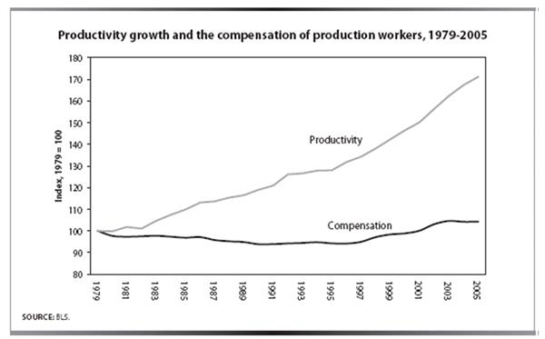
It Doesn’t Trickle Down!
Productivity Growth and Worker Compensation 1979-2005
PRODUCTIVITY
COMPENSATION

Slide 19
This is New in Recent History

Slide 20
Hurting The Poor And Middle Class
Share of total wealth gain, 1983 - 2009
81.7%
50.0%
40.2%
41.5%
40.0%
30.0%
20.0%
-7.5%
Share of total wealth gain %
10.2%
10.0%
9.8%
5.7%
-1.4%
-2.0%
-4.1%
0.0%
Top 1% (99-100)
Next 10% (80-90)
Upper middle fifth
Middle fifth
Lower middle fifth
-10.0%
Lowest fifth
Next 4% (95-99)
Next 5% (90-95)
Source: Mishel analysis of Wolff in Allegretto (2010)

Slide 21
What No Money Can Buy:
50.0%
40.2%
Obesity
41.5%
Teenage births
40.0%
Addiction
Infant Mortality
Mental Illness
30.0%
Homicides
20.0%
Share of total wealth gain %
10.2%
10.0%
9.8%
5.7%
0.0%
Top 1% (99-100)
Next 10% (80-90)
Upper middle fifth
-10.0%
Next 4% (95-99)
Next 5% (90-95)
Literacy
Life expectancy
Math Skills
Social Mobility
Trust

Slide 22
Why Is Inequality Worse?
Structural changes:
Globalization and technology
America Does not Generate “Traded Jobs”
Blaming Americans for not acquiring the skills needed

Slide 23
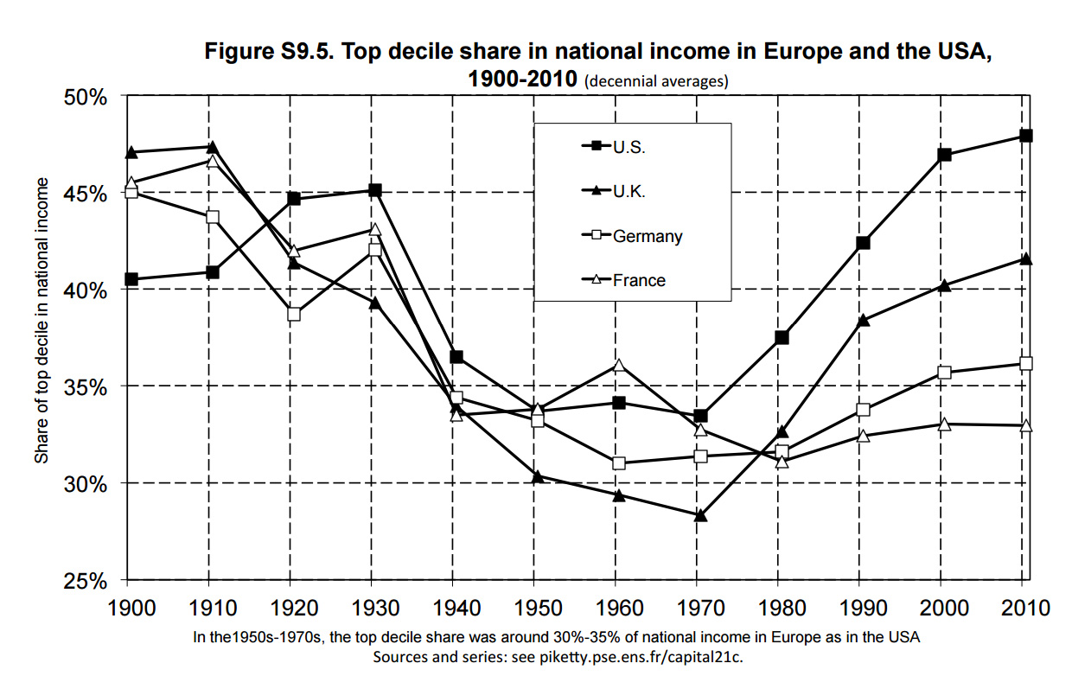
But Why Relatively Worse HERE?
In other countries inequality has not risen as much as it has in the US
Notes:
Is the last point too polemic?

Slide 24
But Why Relatively Worse HERE?
Other countries strengthened cultural, institutional, and market mechanisms to counter inequality
Minimum wage
Taxes
Health care
Social welfare programs
Notes:
Is the last point too polemic?

Slide 25
Why Is Inequality Worse NOW?
“Most of these factors reflect, at least in part, things the federal government either did or failed to do”
Timothy Noah, “The Great Divergence”

Slide 26
Skills – Based Technology Change
America Does not Generate “Traded Jobs”
They blame Americans for not acquiring the skills needed
Notes:
Is the last point too polemic?

Slide 27
Why Is Inequality Worse NOW?
Government policies and programs:
taxes,
education,
minimum wage,
regulation

Slide 28
Major Contributors to Rising Inequality
Rising Inequality
Lower Taxes on Rich
Weaker Unions
De-regulation
Trade
Education decline
Skyrocketing CEO Pay
Notes:
At a time when the workforce needed to be smarter, Americans got dumber…Unlike the computerization trend, the slowdown of educational attainment gains is not occurring in all industrialized nations; it is uniquely American.” Timothy Noah, The Great Divergence
In 1979, the effective tax rate on the top 0.01 percent (i.e., rich people) was 42.9 percent, according to the Congressional Budget Office. By Reagan's last year in office it was 32.2 percent. From 1989 to 2005 (the last year for which data are available), as income inequality continued to climb, the effective tax rate on the top 0.01 percent largely held steady; in most years it remained in the low 30s, surging to 41 during Clinton's first term but falling back during his second, where it remained.

Slide 29
Campaign for the Comfort of the Rich
1964 to 1974, many progressive laws
The rich did not like it
In 1972, the campaign started
National Association of Manufacturers
Chamber of Commerce
Business Roundtable
Heritage Foundation

Slide 30
Campaign for the Comfort of the Rich
Early Victories included defeat of
Office of Consumer Representation
Common Situs Picketing (Labor) Bill
Tax Reform Act of 1978
David Stockman said
“The hogs were really feeding”

Slide 31
Campaign for the Comfort of the Rich
Later Victories included
Further reductions in capital gains tax
Huge reductions in inheritance tax
50% reduction in tax rates paid by the richest
Deregulation of the finance industry
No more Glass Steagall
Commodity Futures Modernization Act

Slide 32
Minimum Wage, for example

Slide 33
Bush Tax Cuts Saved The 0.01%
Year | Tax Savings | Accumulation | Income
2003 | $390,000 | $390,000 | $23,400
2006 | $519,556 | $1,773,331 | $106,400
2009 | $905,773 | $4,032,693 | $241,962
2012 | $1,739,445 | $8,284,217 | $497,053
2015 | $3,432,408 | $16,628,167 | $997,690
Population total |  | $497,182,198,424

Slide 34
2014 Underserved Market Report
Near-elimination of usury laws
68 million U.S. adults are underbanked
$138 Billion (in fees) Market
That’s about $2,000 per adult

Slide 35
Why Has Inequality Gotten Worse?
POLITICIANS
Need more and more money for elections
Depend more on rich donors
RICH ELITES
Buy access and privileges
Get richer
THE REST
Get poorer
Change the rules of the game in their favor
Buy more access and privileges
Have less say
GIVE UP
Notes:
In his 2008 book Unequal Democracy, Larry Bartels, a Princeton political scientist, writes:
[T]he narrowly economic focus of most previous studies of inequality has caused them to miss what may be the most important single influence on the changing U.S. income distribution over the past half-century—the contrasting policy choices of Democratic and Republican presidents. Under Republican administrations, real income growth for the lower- and middle-classes has consistently lagged well behind the income growth rate for the rich—and well behind the income growth rate for the lower and middle classes themselves under Democratic administrations.
In Democrat-world, pre-tax income increased 2.64 percent annually for the poor and lower-middle-class and 2.12 percent annually for the upper-middle-class and rich. There was no Great Divergence. Instead, the Great Compression—the egalitarian income trend that prevailed through the 1940s, 1950s, and 1960s—continued to the present, albeit with incomes converging less rapidly than before. In Republican-world, meanwhile, pre-tax income increased 0.43 percent annually for the poor and lower-middle-class and 1.90 percent for the upper-middle-class and rich. Not only did the Great Divergence occur; it was more greatly divergent.

Slide 36
People Blame Big Government
BIG GOVERNMENT
BIG BUSINESS
1965
2010

Slide 37
We Have a Chance!
The real causes of rising inequality are in our politics, so
they are in our beliefs
and in our control
Not in inexorable forces

Slide 38
What Should Happen?
Limit lobbying and campaign contributions
Increase the power of common citizens
Organize common citizens for a long-haul struggle

Slide 39
What Can We Do?
Learn, share, teach
Make your views known
Join with others
Challenge money in politics
If you can’t stop it, expose it

Slide 40
Is It Hopeless?
How much did PACs raise for Trump and Sanders this year?
How well did they do?
As time goes by, money will be less potent in politics

Slide 41
Good News--We Are Waking Up!

Slide 42
Income Inequality

Slide 43
Financial Services for the Underbanked

Slide 44
Payday Loans
To borrow $300 from a payday lender,
You pay a fee $20 per $100
If you can’t pay in two weeks,
you pay another $60 to roll the loan over
That’s 520% interest (APR)
Alabama Appleseed says the average payday borrower pays 37 percent of his or her income to the lender.

Slide 45
Tax Refund Anticipation
Tax preparers no longer offer “refund anticipation loans”
H&R Block offers "refund anticipation checks." -- at a cost of $48
The taxpayer does not know the preparer’s fee until the end
A paper check costs another $25

Slide 46
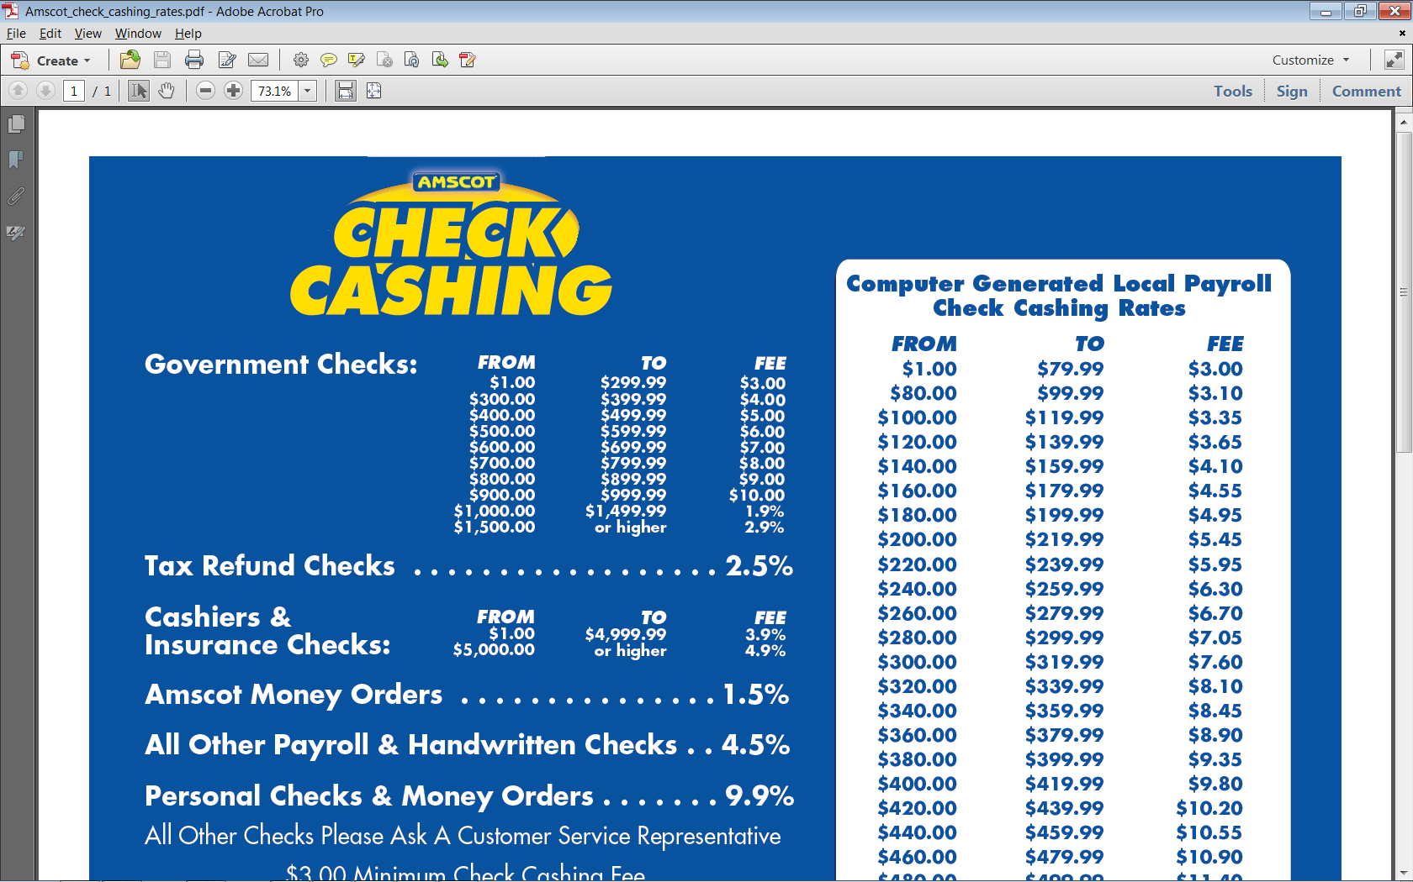
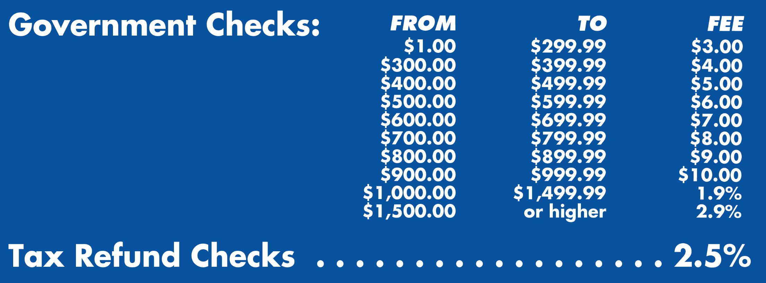
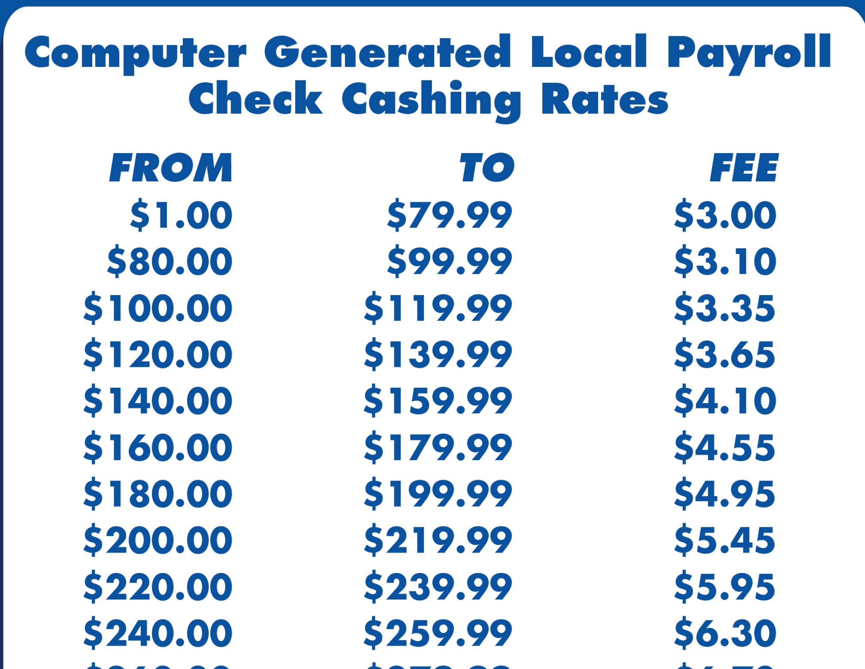
Check Cashing

Slide 47
Bill Payment

Slide 48
Sub-Prime Auto Loans
For a $20,000 Auto Loan
With “Good Credit” you pay 9.4%
With “Poor Credit” you pay 14.8%
Buy Here – Pay Here lots
High Loan Rates
The Cars Aren’t Good
Yo-Yo Loan Scams

Slide 49
Financial Services for the Underbanked

Slide 50
What’s the Answer?
How can People Break the Cycle?
Saving $300 one time, and never spending it, can pay $150 a year for your lifetime
Credit Unions
Community Support

Slide 51
Credit Unions
Non-profit institutions that serve the community.
National Credit Union Foundation
REAL (“Relevant, Effective, Asset-building, Loyalty-producing”) Solutions
Affordable small-dollar loan products to those with limited assets.

